Slide 1
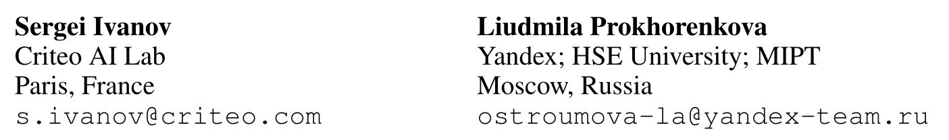



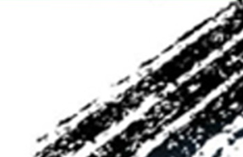

Boost then Convolve: Gradient Boosting Meets Graph Neural Networks
ICLR 2021
Code: github.com/nd7141/bgnn
2021.05.23 • ChongQing
Reported by Chenghong Li

Slide 2

Introduction
Graph neural networks (GNNs) are powerful models that have been successful in various graph representation learning tasks.
Whereas gradient boosted decision trees (GBDT) often outperform other machine learning methods when faced with heterogeneous tabular data.
We propose a novel architecture that trains GBDT and GNN jointly to get the best of both worlds.
The GBDT model deals with heterogeneous features, while GNN accounts for the graph structure.

Slide 3
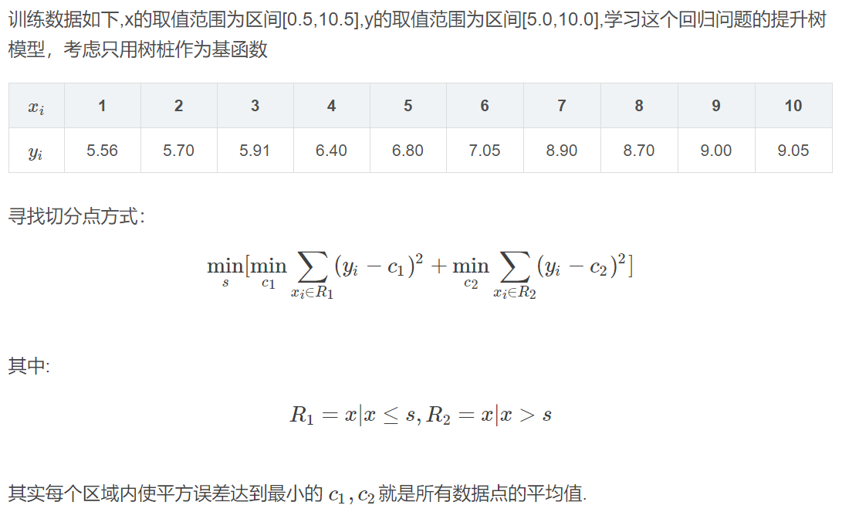
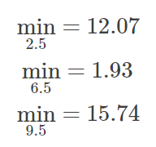
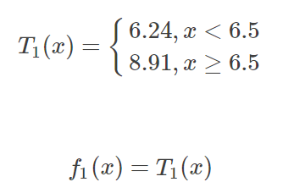
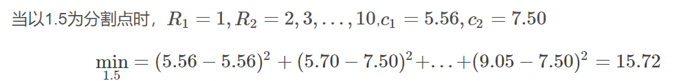




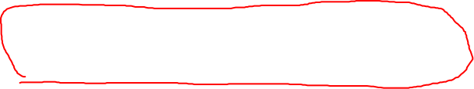


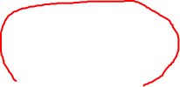









Method
BDT
...
...

Slide 4
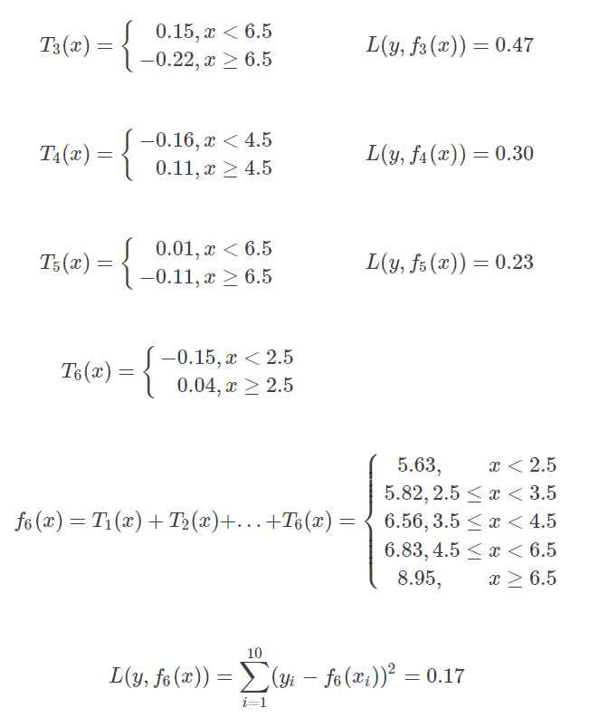
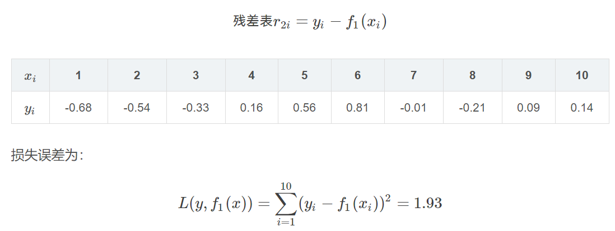

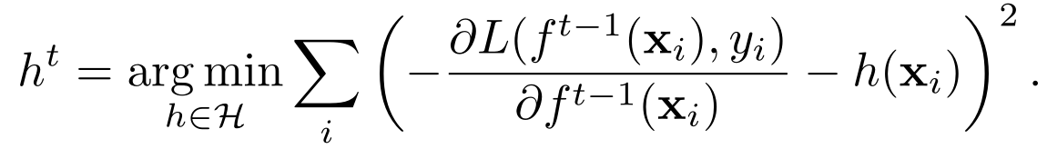



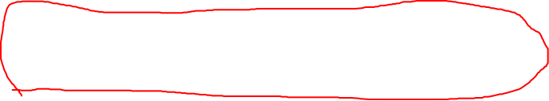






Method
BDT
GBDT

Slide 5
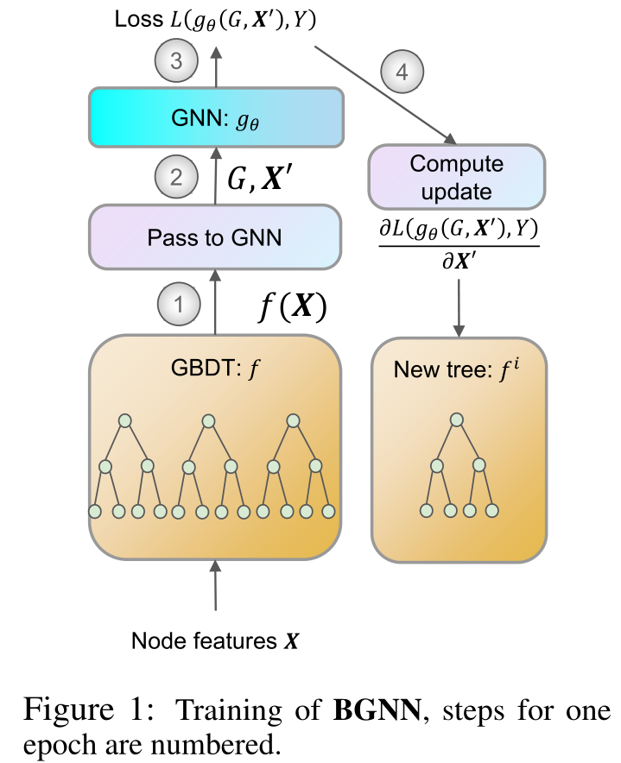


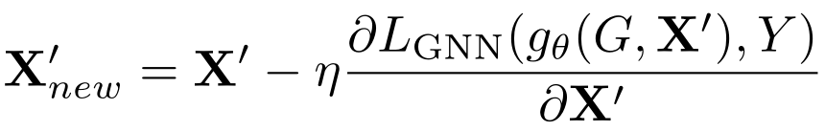


















Method
... ...

Slide 6
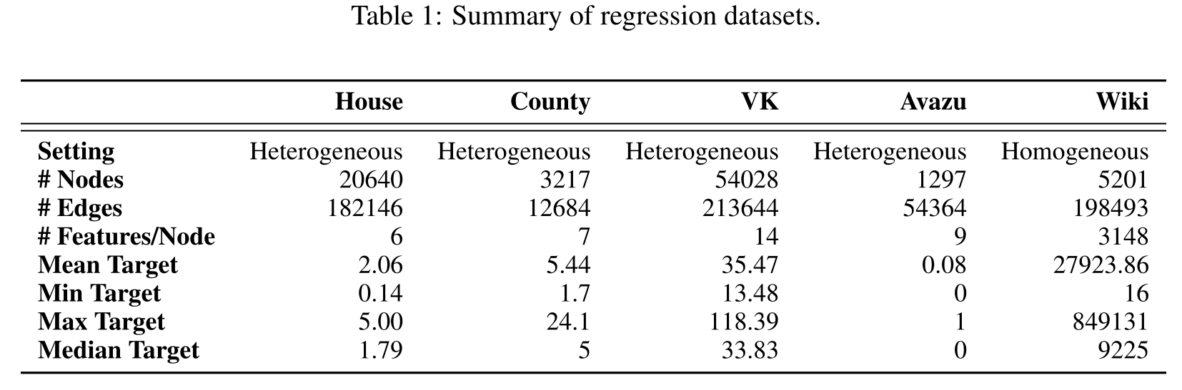
Experiments

Slide 7
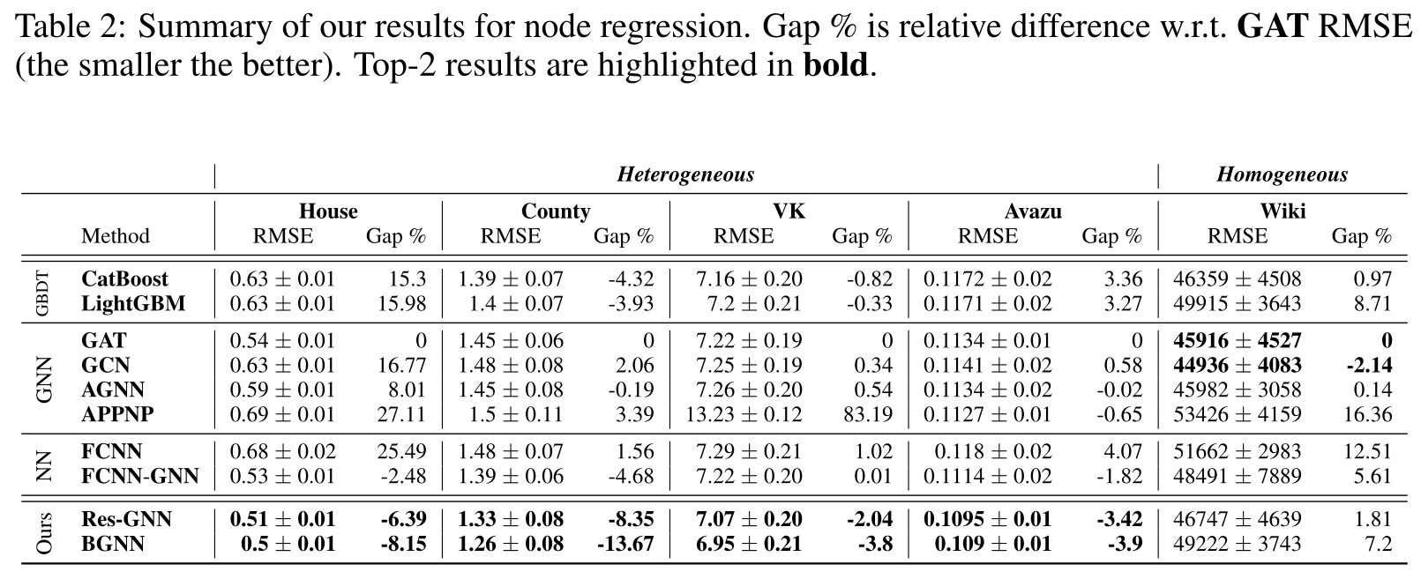
Experiments

Slide 8
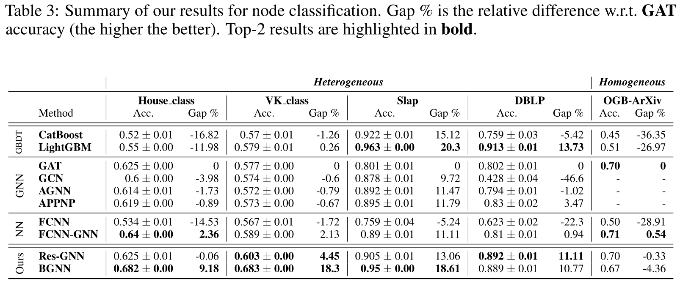
Experiments

Slide 9
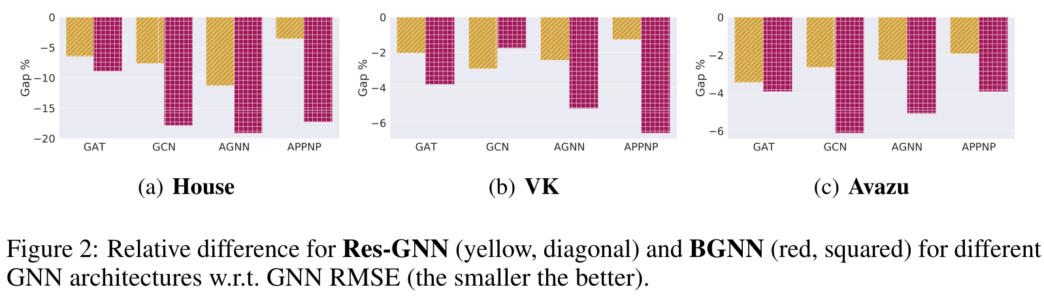
Experiments

Slide 10
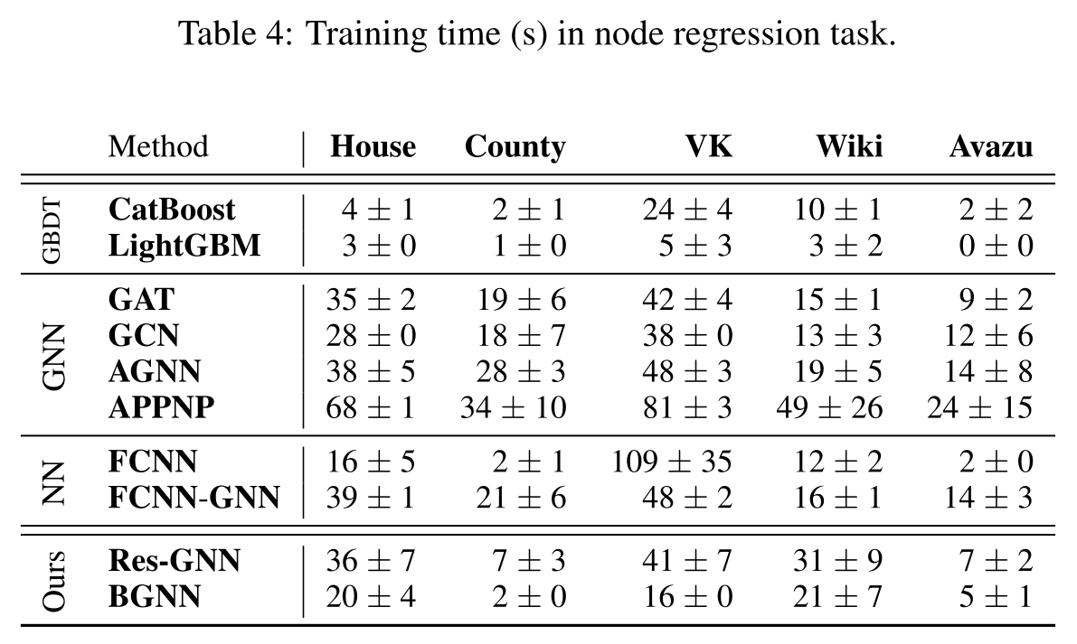
Experiments

Slide 11
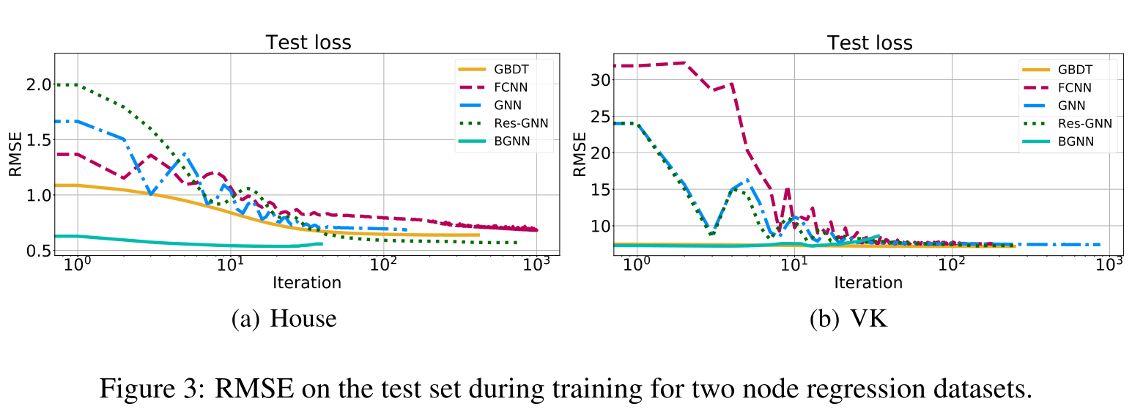
Experiments

Slide 12
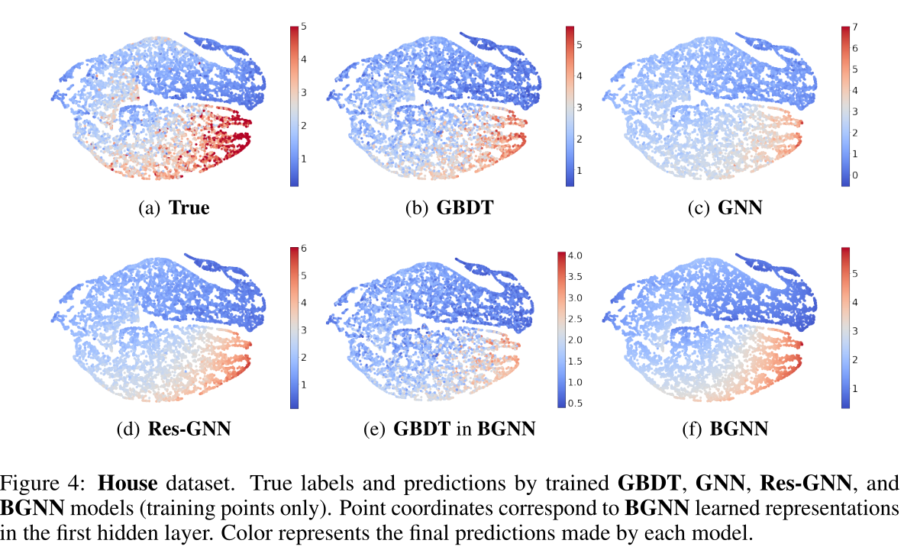
Experiments

